Slide 1
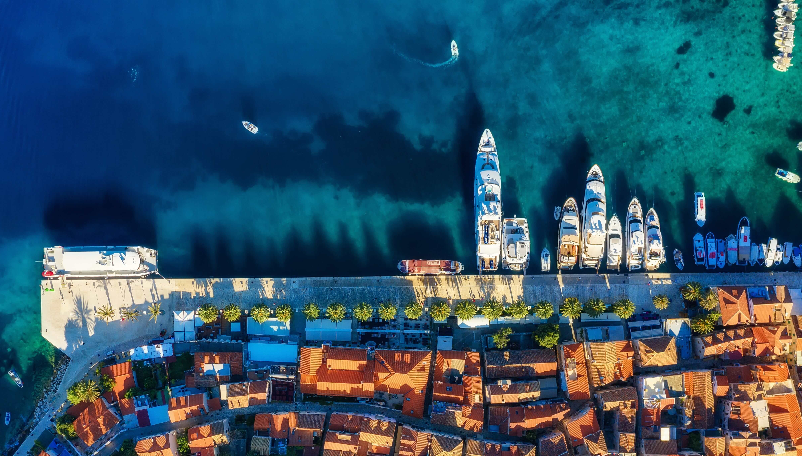
A “Week of BLUE CHALLENGE”
23-29/11/2022 Kotor, Montenegro
Sustainable development of BLUE economies through higher education and innovation in Western Balkan Countries
Project no. 609693-EPP-1-2019-1-NO-EPPKA2-CBHE-JP

Slide 2
Title
Item 1
Item 2
Item 3

